Slide 1


Twitter Analysis Trump Marketing & PR Identify key Topics, Perception & Influencers
Team:
Du Weilin
Jenny White
Vishal Agarwal
Sakshi Joshi
Sharan Salem
Felista Muganda

Slide 2
PROJECT OBJECTIVE
Using twitter data to identify positive and negative influencers for Donald Trump, their topics of conversation and their network outreach.
Tools and Packages Used
TweetScraper
Tweepy
Silenium
NLTK
Spacy
pyLDAvis
TextBlob
Gephi

Slide 3
METHODOLOGY
Business Methodology
Business Objective Breakdown
Technical Analysis
Network Visualization
Observations and Strategies
Scrape Twitter
Influence Matrix
Data Cleaning
Topic Modeling
Sentiment Analysis

Slide 4
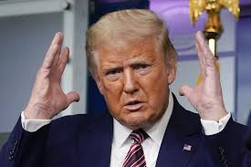
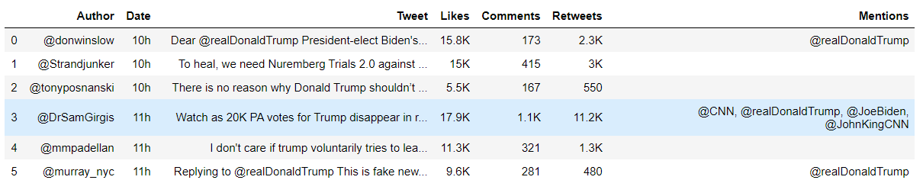
DATA SCRAPING
Tools
GetOldTweets
TweetScraper
Tweepy
Silenium
Tweet Filters
Date – Last 6 months
Mention- Donald Trump
Minimum likes/ retweets/ comments (100)
Author Details using Tweepy
So Many Tweets

Slide 5
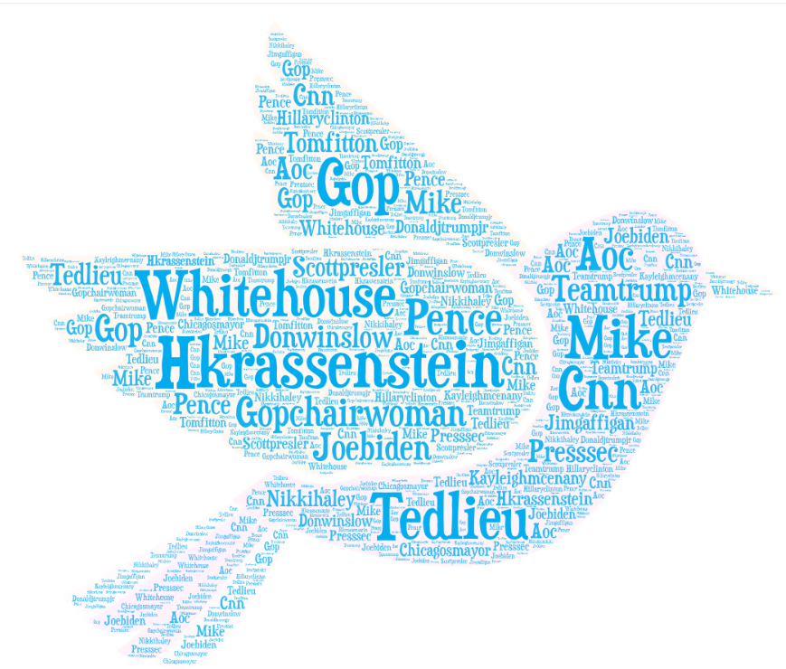

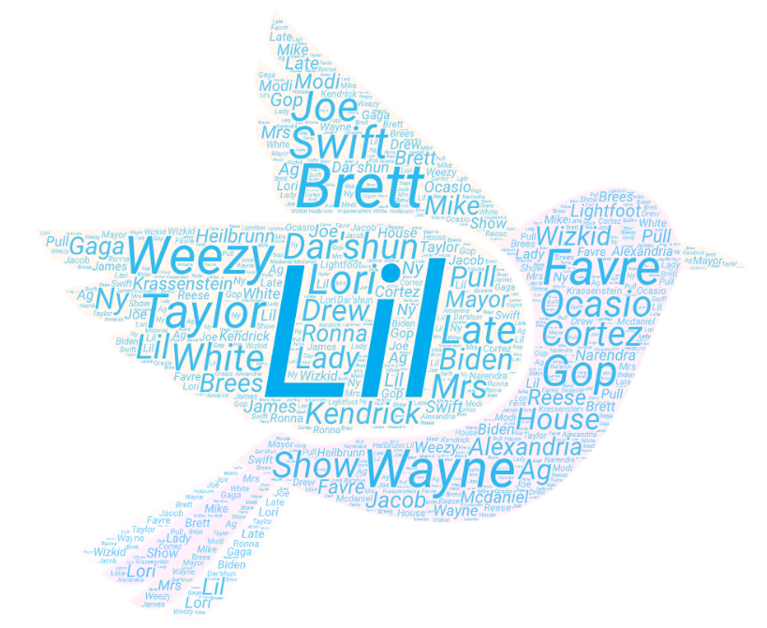
INFLUENCE MATRIX
Factors
Tweet Count
Average Likes
Average Comments
Average Retweets
Followers Count
Account Type
0.4*Tweet_Count + 0.05*Average_Likes
+ 0.15*Average_comments
+ 0.2*Average_retweets
+ 0.05*Followers_Count
+ .05*new_author['Verified']
0.6*Tweet_Count
+ 0.05*Average_Likes
+ 0.2*Average_comments
+ 0.05*Average_retweets
+ 0.1*new_author['Verified']
Challenge: Max People with 1-5 Tweets
Final – Some have 1 tweet but high reach

Slide 6
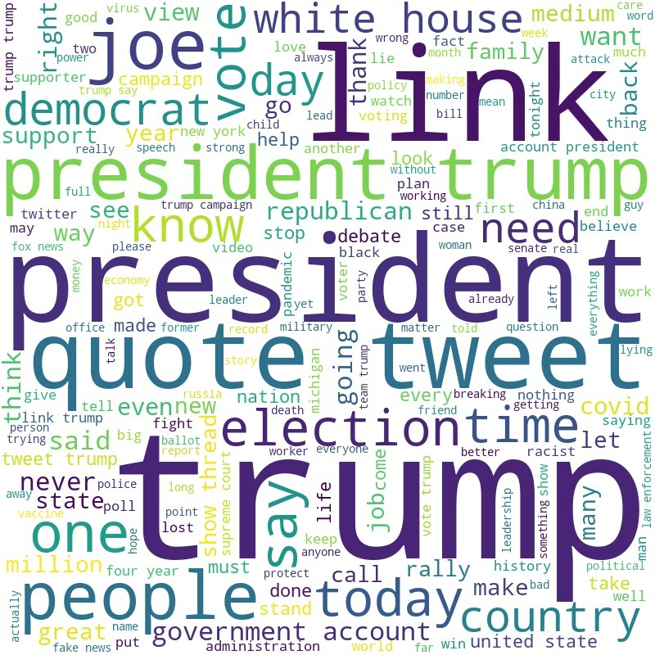
DATA CLEANING
Parameters
Link Removal
Extract Mentions
Special Characters
Stopwords
Lemmatization
Non English Words
Integer Formatting

Slide 7
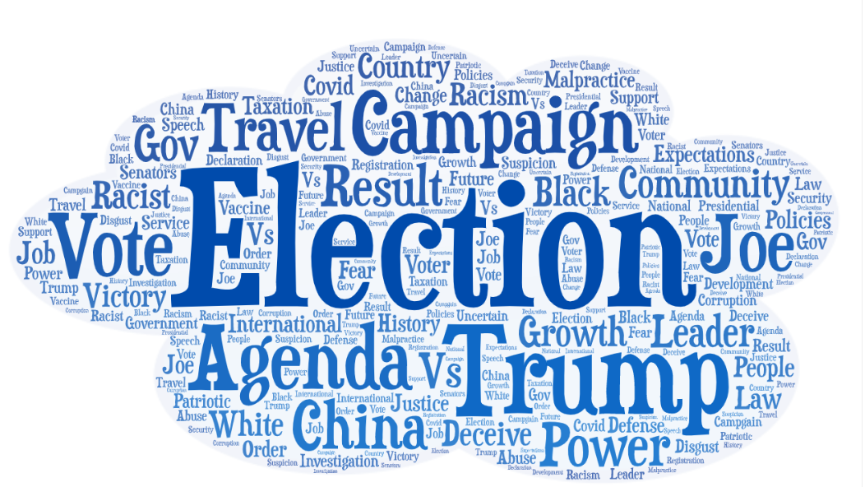
TOPIC MODELING
Parameters
LDA using genism
Top Influencers
Author | Words | Topic
GopChairWoman | Shut, page, already, ramp, investigation, speech, text, lift | Investigation
Tedleiu | Black, night, take, women, military, life, justice, city | Justice, ??
CNN | Birthday, city, official, vote, positive, corrupt, piss, calling | Corruption
Hkrassenstein | Country, law, campaign, breaking, order, news, great, soldier | Agenda ??
HillaryClinton | Viewer, disastrous, sad, loser, talent, night | Fear

Slide 8
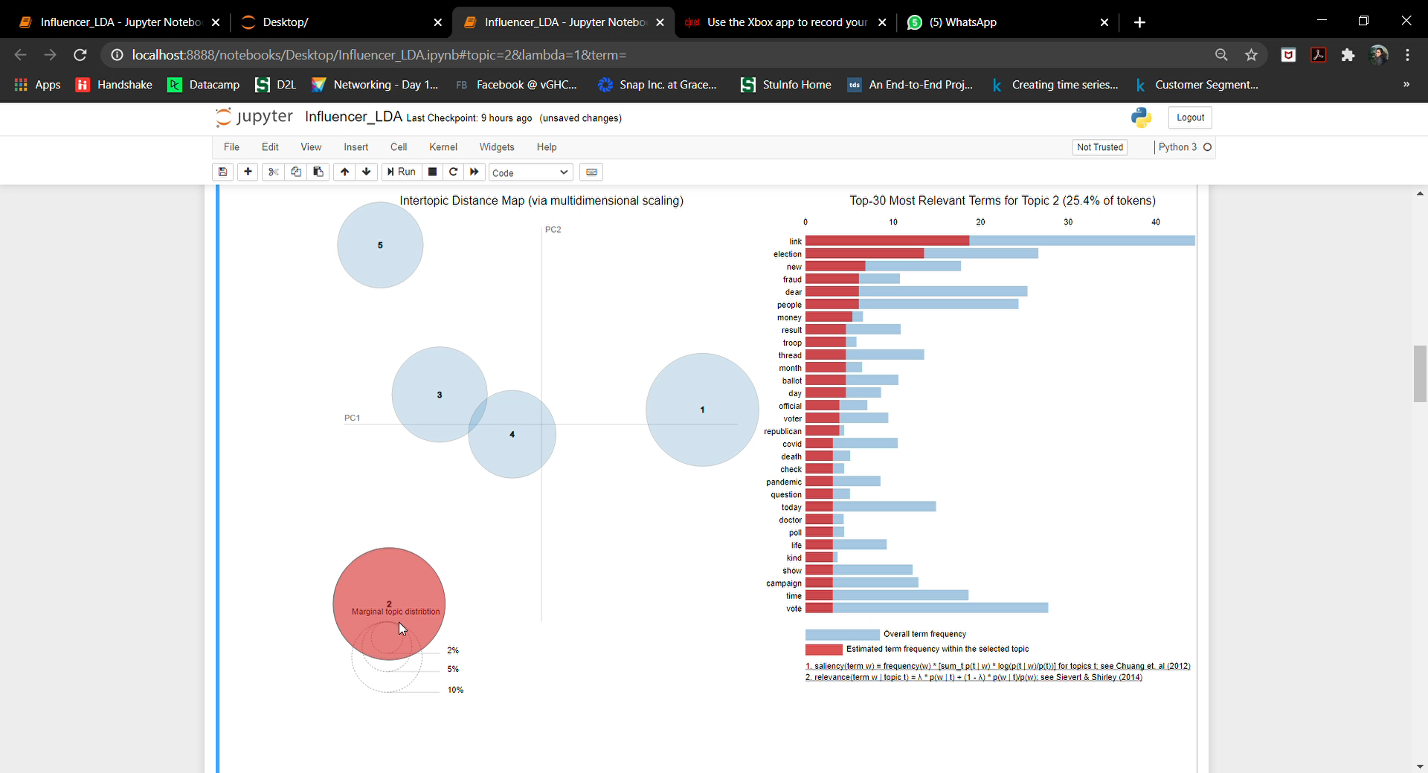
INFLUENCER VISUALIZATION

Slide 9
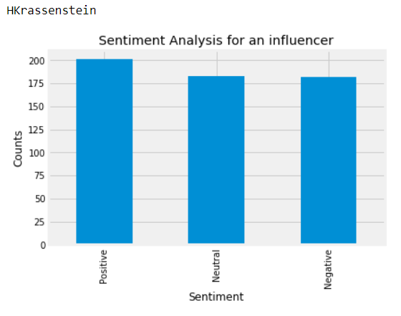
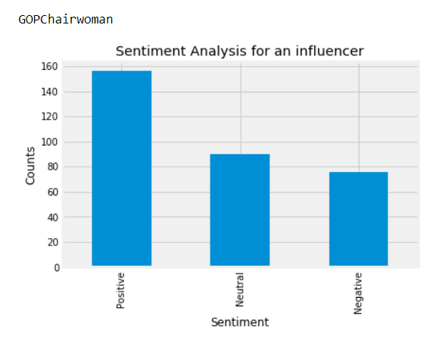
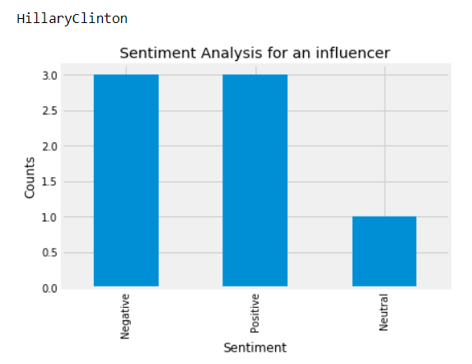
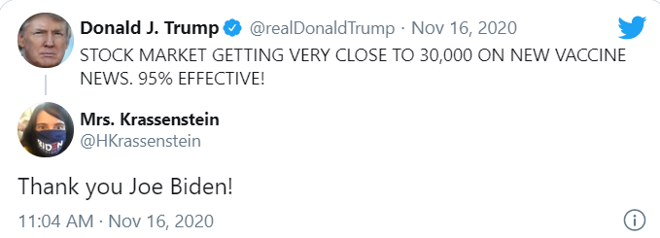
SENTIMENT ANALYSIS
For the top influencers, most tweets have a positive sentiment except a few
3 of the top 20 influencers have high polarity, i.e. either positive or negative.

Slide 10
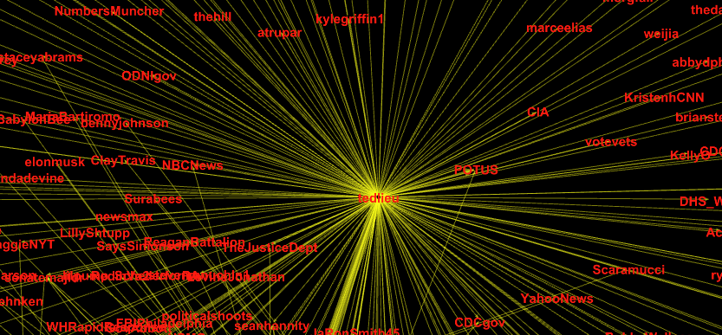
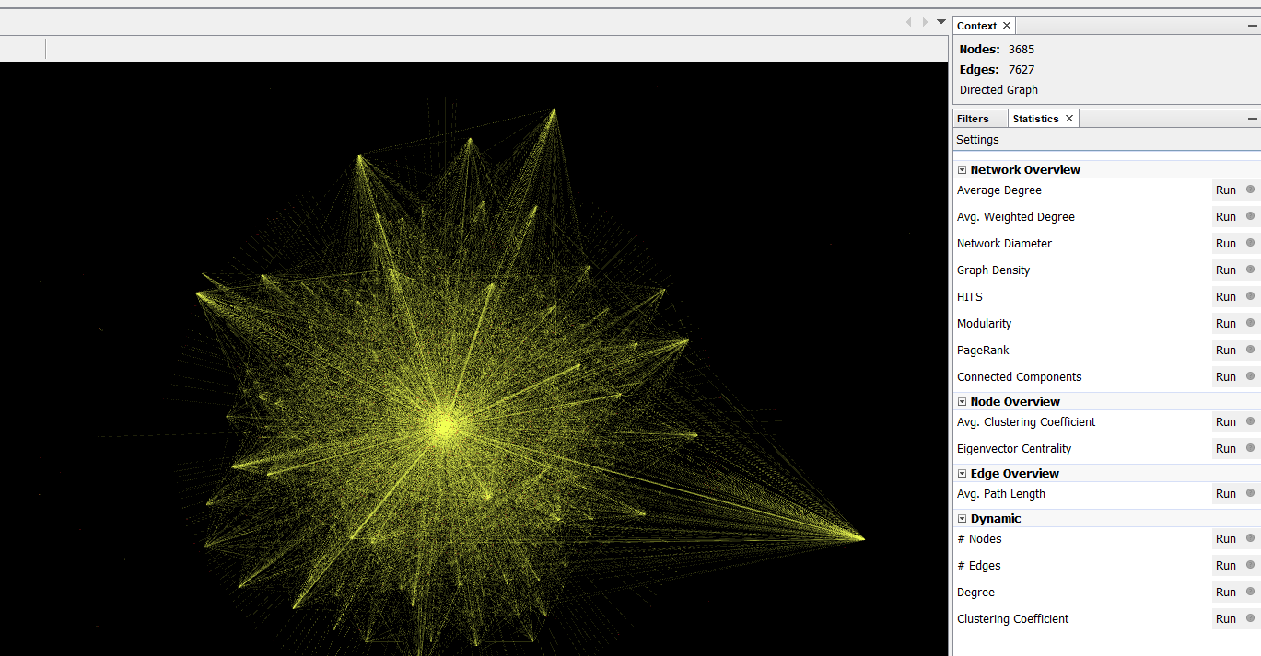
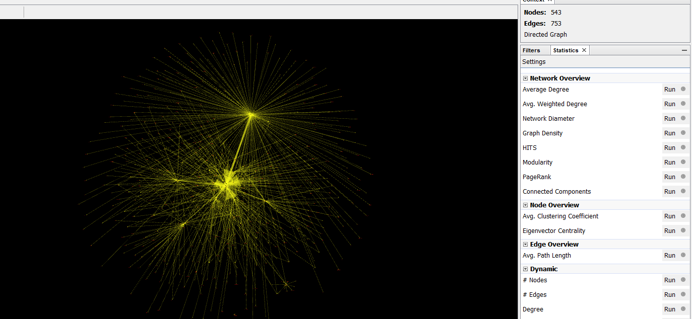
NETWORK VISUALIZATION
Network Analysis – Complete Data
Network Analysis – Top Influencer Data

Slide 11
BUSINESS STRATEGY
INFLUENCERS
CONTENT DESIGN
EXTENDED NETWORK
Catering to identified influencers gives an edge to the PR team
It can also be a long-term association with specific influencers
Topics identified across various influencers can be a rich source of content
Further Analysis can show the tweets which garner more engagement
Negative content can be managed by reaching to the mentions and accessing the extended network
The network graph can be filtered across various parameters to align with the topics being covered

Slide 12

Thank You
All team members can take questions!

